Slide 1

DESIGN & ANALYSIS OF ALGORITHMS
(01AI0506)

Slide 2
Algorithm
Def. 1:
It is a combination (or sequence) of finite steps to solve a particular problem.
Def. 2:
It is a well-defined procedure which will take a set of values as input and which will produce a set of values as output.
Def. 3:
You can also view an algorithm as a tool for solving a well-specified computational problem.

Slide 3



Algorithm - Example 1
Input: Ingredients(water/milk, sugar, coffee powder)
Output: A cup of coffee
Steps:
Pour drinking water into electric kettle
Plug electric kettle and wait for it to boil
While waiting, prepare coffee cup
Add instant coffee powder into cup
Check boiling water
If water is boiled, unplug kettle and pour water into cup
If water is not boiled, press the “on” switch to continue and wait until boiled
Refer back to step 6
Stir coffee mix
Drink!

Slide 4
Algorithm - Example 2
Write down the steps for making peanut butter and jelly sandwich.
Steps for making a peanut butter and jelly sandwich: Step 1: Take 2 slices of bread. Step 2: Apply peanut butter on one side of a slice. Step 3: Apply jelly on one side of the other slice. Step 4: Press both the slices of bread together.

Slide 5
Design and Analysis
Algorithm is a branch of computer science that consists of designing and analyzing computer algorithms.
The “design” pertain to
The description of algorithm at an abstract level by means of a pseudo language
Proof of correctness that is, the algorithm solves the given problem in all cases.
The “analysis” deals with performance evaluation (complexity analysis).

Slide 6
Algorithm
Suppose that you need to sort a sequence of numbers into monotonically increasing order.
This problem arises frequently in practice and introducing many standard design techniques.
Here is how we formally define the sorting problem:
Input: A sequence of n numbers 〈a₁, a₂, … , a_{n}〉
Output: A permutation (reordering) 〈a’₁, a’₂, … , a’_{n}〉 of the input sequence such that a’₁ <= a’₂ <= … <= a’_{n}

Slide 7
Algorithm
Thus, given the input sequence 〈31, 41, 59, 26, 41, 58〉, a correct sorting algorithm returns as output the sequence 〈26, 31, 41, 41, 58, 59〉.
Such an input sequence is called an instance of the sorting problem.
In general, an instance of a problem consists of the input (satisfying whatever constraints are imposed in the problem statement) needed to compute a solution to the problem.

Slide 8
Algorithm
An algorithm for a computational problem is correct
if, for every problem instance provided as input, it halts—finishes its computing in finite time—and outputs the correct solution to the problem instance.
A correct algorithm solves the given computational problem.
An incorrect algorithm might not halt at all on some input instances, or it might halt with an incorrect answer.

Slide 9
Characteristics of Algorithm
Unambiguous − Algorithm should be clear and unambiguous. Each step, and their input/outputs should be clear and only one meaning.
Input − An algorithm should have 0 or more well defined inputs.
Output − An algorithm should have 1 or more well defined outputs and should match the desired output.
Finiteness − Algorithms must terminate after a finite number of steps.
Feasibility − Should be feasible with the available resources.
Independent − An algorithm should have step-by-step directions which should be independent of any programming code.

Slide 10
Characteristics of Algorithm
Example 1: Finding the Largest of Two Numbers
Start
Read A and B
Print "A is the largest"
Stop
Incorrect Algorithm (Steps not properly related):
Problem: The algorithm prints that A is the largest without comparing A and B. Step 3 is not logically connected to the previous step.

Slide 11
Characteristics of Algorithm
Example 1: Finding the Largest of Two Numbers
Correct Algorithm:
Start
Read A and B
Compare A and B
If A > B, print "A is the largest"; otherwise, print "B is the largest"
Stop
Here, each step naturally follows from the previous one.

Slide 12
Characteristics of Algorithm
Example 2: ATM Cash Withdrawal
Insert ATM card.
Enter PIN.
Dispense cash.
Stop.
Incorrect Algorithm:
Problem: The algorithm never verifies whether the PIN is correct or whether sufficient balance exists.

Slide 13
Characteristics of Algorithm
Example 2: ATM Cash Withdrawal
Correct Algorithm:
Insert ATM card.
Enter PIN.
Verify PIN.
Check account balance.
If balance is sufficient, dispense cash; otherwise, display ”Low Bal."
Stop.

Slide 14
Role of Algorithm in Computing
Algorithms are used to find the best possible way to solve a problem, based on data storage, sorting and processing.
Algorithms play a crucial role in computing by providing a set of instructions for a computer to perform a specific task.
They are used to solve problems and carry out tasks in computer systems.

Slide 15
Role of Algorithm in Computing
Algorithms are widely used in various industrial areas to improve efficiency, accuracy, and decision-making.
Some of the key applications include:
Manufacturing
Finance
Healthcare
Retail
Transportation
Energy

Slide 16
Role of Algorithm in Computing
Algorithms are fundamental to computing and play a crucial role in many aspects of the field.
Some of the key needs and applications of algorithms in computing include:
Data processing
Problem solving
Computer graphics
Artificial Intelligence
Database management
Network communication
Operating systems

Slide 17
Role of Algorithm in Computing
Algorithms play a critical role in networking and communication systems, enabling efficient and reliable data transfer and communication.
Some of the key applications of algorithms in networking include:
Routing
Error correction
Data compression
Network security
Quality of Service
Wireless networks
Network topology

Slide 18
Algorithm Specification
Algorithm can be described in three ways.
Natural language like English:
In this case, a care should be taken, we should ensure that each & every statement is definite.
Graphic representation called flowchart:
This method will work well when the algorithm is small & simple.
Pseudo-code Method:
In this method, we should typically describe algorithms as program, which resembles language like Pascal.

Slide 19
Pseudo-Code Conventions
1. Comments begin with // and continue until the end of line.
2. Blocks are indicated with matching braces {and}.
3. An identifier begins with a letter. The data types of variables are not
explicitly declared.
4. Compound data types can be formed with records.
Example:
Node. Record
{
data type – 1 data-1;
.
data type – n data – n;
node * link;
}

Slide 20
Pseudo-Code Conventions
5. Assignment of values to variables is done using the assignment statement.
<Variable>= <expression>;
6. There are two Boolean values TRUE and FALSE.
Logical Operators AND, OR, NOT
Relational Operators <, <=,>,>=, =, !=
7. The looping statements are employed with algorithms.
Like for, while and repeat-until

Slide 21
Pseudo-Code Conventions
8. A conditional statement has the following forms.
If <condition> then <statement>
If <condition> then <statement-1>
Else <statement-1>
9. Input and output are done using the instructions read & write.
10. There is only one type of procedure:
Algorithm, the heading takes the form,
Algorithm Name (Parameter lists)

Slide 22
Algorithm in description
Euclid’s algorithm for computing gcd(m, n)
Step 1: If n = 0, return the value of m as the answer and stop; otherwise, proceed to Step 2.
Step 2: Divide m by n and assign the value of the remainder to r.
Step 3: Assign the value of n to m and the value of r to n. Go to Step 1.

Slide 23
Algorithm in Pseudo-Code
ALGORITHM Euclid(m, n)
//Computes gcd(m, n) by Euclid’s algorithm
//Input: Two nonnegative, not-both-zero integers m and n
//Output: Greatest common divisor of m and n
while n = 0 do
r ←m mod n
m←n
n←r
return m

Slide 24
Designing and analyzing an algorithm
A sequence of steps one typically goes through in designing and analyzing an algorithm for solving the problems.
Understand the problem
Decision making on:
Ascertaining the capabilities of a computational device
Choosing between exact and approximate problem solving
Deciding on appropriate data structures
Algorithm design techniques
Methods of specifying an algorithm
5) Proving an algorithm's correctness
6) Analysing an algorithm
7) Coding an algorithm

Slide 25
1.Understanding the Problem
This is the first step in designing of algorithm.
Read the problem’s description carefully to understand the problem statement completely.
Ask questions for clarifying the doubts about the problem.
Identify the problem types and use existing algorithm to find solution.
Input (instance) to the problem and range of the input get fixed.

Slide 26
2. Decision making
The Decision making is done on the following
a) Ascertaining the Capabilities of the Computational Device
In random-access machine (RAM), instructions are executed one after another. Accordingly, algorithms designed to be executed on such machines are called sequential algorithms.
In newer computers, operations are executed concurrently, i.e., in parallel. Algorithms that take advantage of this capability are called parallel algorithms.
Choice of computational devices like Processor and memory is mainly based on space and time efficiency.

Slide 27
2. Decision making (Conti…)
b) Choosing between Exact and Approximate Problem Solving:
The next principal decision is to choose between solving the problem exactly or solving it approximately.
An algorithm used to solve the problem exactly and produce correct result is called an exact algorithm.
If the problem is so complex and not able to get exact solution, then we have to choose an algorithm called an approximation algorithm. i.e., produces an Approximate answer.
E.g., extracting square roots, solving nonlinear equations

Slide 28
2. Decision making(Conti…)
c) Algorithm Design Techniques
An algorithm design technique (or “strategy” or “paradigm”) is a general approach to solving problems algorithmically that is applicable to a variety of problems from different areas of computing.
Algorithms + Data Structures = Programs
Though Algorithms and Data Structures are independent, but they are combined together to develop program. Hence the choice of proper data structure is required before designing the algorithm.

Slide 29

2. Decision making(Conti…)
c) Algorithm Design Techniques(Conti…)
Implementation of algorithm is possible only with the help of Algorithms and Data Structures
Algorithmic strategy / technique / paradigm are a general approach by which many problems can be solved algorithmically.
E.g., Brute Force, Divide and Conquer, Dynamic Programming, Greedy Technique and soon.

Slide 30
3.Designing an Algorithm and Data Structures
After deciding the design techniques, we need to decide the approaches. There are two approaches for designing an algorithm. These approaches include
Top-Down Approach
Bottom-up approach
Top-Down Approach: In the top-down approach, a large problem is divided into small sub-problem. and keep repeating the process of decomposing problems until the complex problem is solved.

Slide 31
3.Designing an Algorithm and Data Structures
Bottom-up approach: The bottom-up approach is also known as the reverse of top-down approach. In this approach, different parts of a complex program is solved and then this is combined into a complete program.
Methods of Specifying an Algorithm is also required. Those methods are,
Natural language like English
Graphic representation called flowchart
Pseudo-code Method

Slide 32
4. Proving an Algorithm’s Correctness
Once an algorithm has been specified then its correctness must be proved.
An algorithm must yield a required result for every legitimate input in a finite amount of time.
For Example, the correctness of Euclid’s algorithm for computing the greatest common divisor stems from the correctness of the equality gcd(m, n) = gcd(n, m mod n).

Slide 33
4. Proving an Algorithm’s Correctness
A common technique for proving correctness is to use mathematical induction because an algorithm’s iterations provide a natural sequence of steps needed for such proofs.
The notion of correctness for approximation algorithms is less straightforward than it is for exact algorithms.
The error produced by the algorithm should not exceed a predefined limit.

Slide 34
5. Analyzing an Algorithm
For an algorithm the most important is efficiency. In fact, there are two kinds of algorithm efficiency.
They are:
Time efficiency, indicating how fast the algorithm runs.
Space efficiency, indicating how much extra memory it uses.
The efficiency of an algorithm is determined by measuring both time efficiency and space efficiency.

Slide 35
5. Analyzing an Algorithm
So factors to analyze an algorithm are:
Time efficiency of an algorithm
Space efficiency of an algorithm
Simplicity of an algorithm
Generality of an algorithm

Slide 36
6. Coding an Algorithm
The coding / implementation of an algorithm is done by a suitable programming language like C, C++,etc.
The transition from an algorithm to a program can be done either incorrectly or very inefficiently. Implementing an algorithm correctly is necessary. The Algorithm power should not reduce by in efficient implementation.
Standard tricks like computing a loop’s invariant (an expression that does not change its value) outside the loop, collecting common subexpressions, replacing expensive operations by cheap ones, selection of programming language and so on should be known to the programmer.

Slide 37
6. Coding an Algorithm
Typically, such improvements can speed up a program only by a constant factor, whereas a better algorithm can make a difference in running time by orders of magnitude. But once an algorithm is selected, a 10–50% speedup may be worth an effort.
It is very essential to write an optimized code (efficient code) to reduce the burden of compiler.

Slide 38
Example 1
A doctor needs to determine whether an image represents a cancerous tumour or a benign one.
The doctor has available images of many other tumours, some of which are known to be cancerous and some of which are known to be benign.
A cancerous tumour is likely to be more similar to other cancerous tumour than to benign tumour, and a benign tumour is more likely to be similar to other benign tumours.
By using a clustering algorithm, the doctor can identify which outcome is more likely

Slide 39
Example 2
You need to compress a large file containing text so that it occupies less space.
Many ways to do so are known, including “LZW compression,” which looks for repeating character sequences.
Another approach is “Huffman coding”, which encodes characters by bit sequences of various lengths, with characters occurring more frequently encoded by shorter bit sequences.

Slide 40
Analyzing Algorithm
Analyzing an algorithm means predicting the resources that the algorithm requires.
Most often, we want to measure computational time.
If you analyze several candidate algorithms for a problem, you can identify the most efficient one. There might be more than just one viable candidate, but you can often rule out several inferior algorithms in the process.

Slide 41
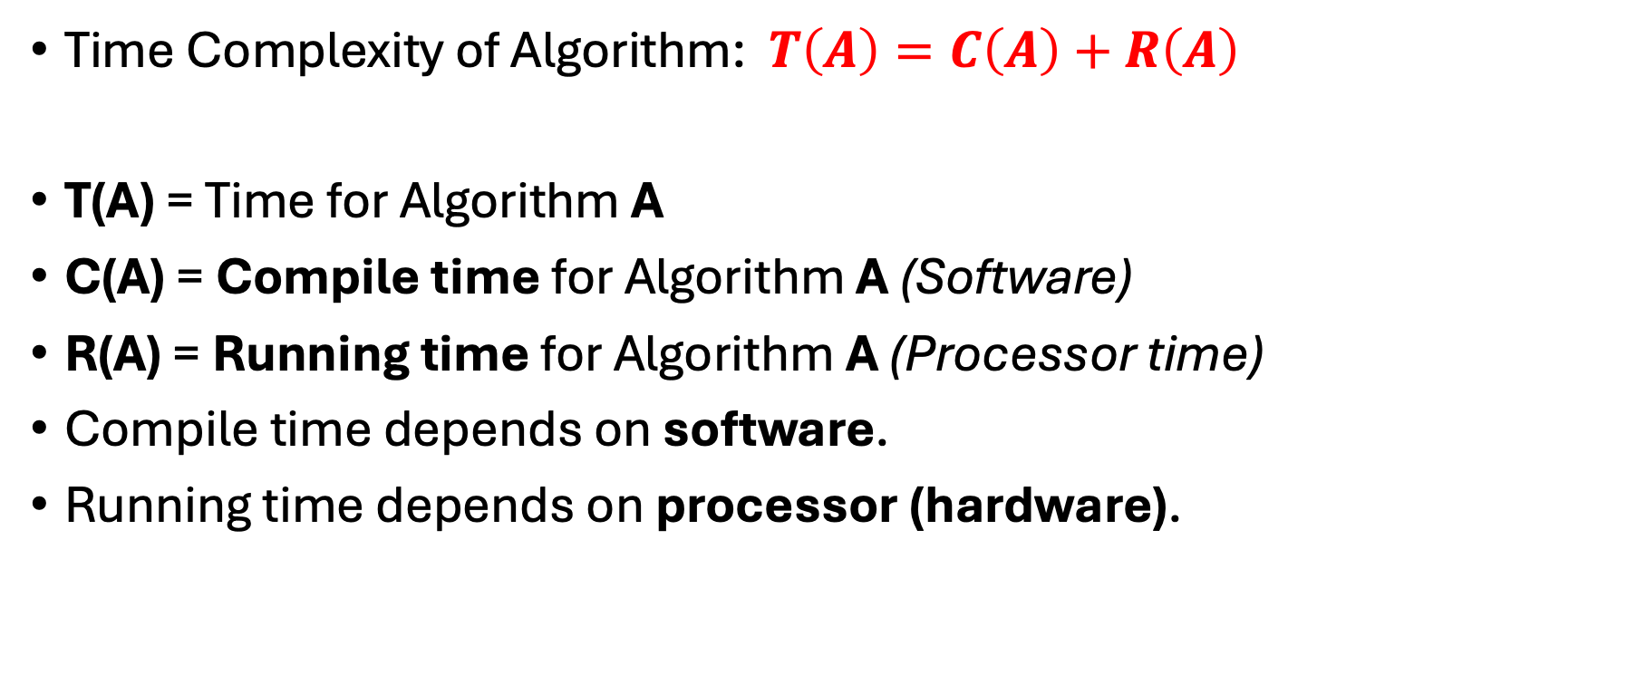
Analysis of Algorithm
Time Complexity of Algorithm: $T\left(A\right)=C\left(A\right)+R\left(A\right)$
T(A) = Time for Algorithm A
C(A) = Compile time for Algorithm A (Software)
R(A) = Running time for Algorithm A (Processor time)
Compile time depends on software.
Running time depends on processor (hardware).

Slide 42
Efficiency of algorithm
The efficiency of an algorithm is a measure of the amount of resources consumed in solving a problem of size 𝑛.
An algorithm must be analyzed to determine its resource usage.
Two major computational resources are execution time and memory space.
Memory Space requirement can not be compared directly, so the important resource is computational time required by an algorithm.

Slide 43
Efficiency of algorithm
To measure the efficiency of an algorithm requires to measure its execution time using any of the following approaches:
Empirical Approach: To run it and measure how much processor time is needed.
Theoretical Approach: Mathematically computing how much time is needed as a function of input size.

Slide 44
Time complexity
Time complexity of an algorithm quantifies the amount of time taken by an algorithm to run as a function of the length of the input.
Running time of an algorithm depends upon,
Input Size
Nature of Input
Generally, time grows with the size of input, for example, sorting 100 numbers will take less time than sorting of 10,000 numbers

Slide 45
Time complexity
So, running time of an algorithm is usually measured as a function of input size.
Instead of measuring actual time required in executing each statement in the code, we consider how many times each statement is executed.
So, in theoretical computation of time complexity, running time is measured in terms of number of steps/primitive operations performed.

Slide 46
Space complexity
Space complexity, also called Space efficiency, refers to the amount of memory units required by the algorithm in addition to the space needed for its input and output.
When an algorithm is run on a computer, it necessitates a certain amount of memory space.
The amount of memory used by a program to execute it is represented by its space complexity.
Because a program requires memory to store input data and temporal values while running, the space complexity is auxiliary and input space.

Slide 47
How to Analysis of Algorithms
What is Analysis of an Algorithm?
Analyzing an algorithm means calculating/predicting the resources that the algorithm requires.
Analysis provides theoretical estimation for the required resources of an algorithm to solve a specific computational problem.
Two most important resources are computing time (time complexity) and storage space (space complexity).
Why is Analysis required?
By analyzing some of the candidate algorithms for a problem, the most efficient one can be easily identified.

Slide 48
How to Analysis of Algorithms
Goal of analysis of algorithms?
To compare algorithms mainly in terms of running time but also in terms of other factors (e.g., memory requirements, programmer's effort etc.)
Running time analysis?
Determine how running time increases as the size of the problem increases.
Input size
No. of elements in the array
No. of elements in a matrix
No. of bits in the binary representation of the input vertices and edges in a graph, etc.

Slide 49
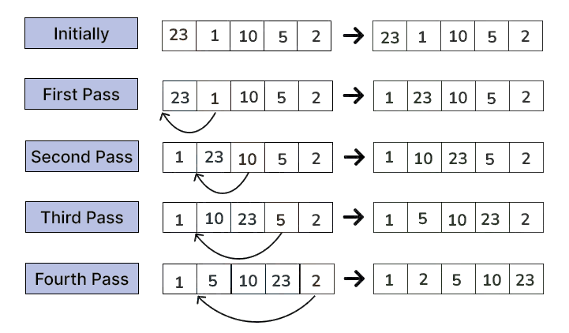
Analysis of Insertion Sort

Slide 50
Analysis of Insertion Sort
How long does the INSERTION-SORT procedure take?
One way to tell would be for you to run it on your computer and note time how long it takes to run.
For that, we need to implement it in some programming language, since you cannot run our pseudocode directly.

Slide 51
Analysis of Insertion Sort
How long insertion sort takes to run on your particular computer, which depends on
Particular input,
Under the particular implementation that you created,
With the particular compiler or interpreter that you ran,
With the particular libraries that you linked in, and
With the particular background tasks that were running on your computer concurrently with your timing test
If you run insertion sort again on your computer with the same input, you might even get a different timing result.

Slide 52
Analysis of Insertion Sort
From running just one implementation of insertion sort on just one computer and on just one input.
How would you be able to determine about insertion sort’s running time with different inputs, on different computer, and implement in a different programming language.
We need a way to predict, given a new input, how long insertion sort will take.
Instead of timing a run, or even several runs, of insertion sort, we can determine how long it takes by analyzing the algorithm itself.

Slide 53
Analysis of Insertion Sort
We’ll examine how many times it executes each line of pseudocode and how long each line of pseudocode takes to run.
How do we analyze insertion sort?
First, let’s acknowledge that the running time depends on the input.
You shouldn’t be terribly surprised that sorting a thousand numbers takes longer than sorting three numbers.
Moreover, insertion sort can take different amounts of time to sort two input arrays of the same size, depending on how nearly sorted they already are.

Slide 54
Analysis of Insertion Sort
Even though the running time can depend on many features of the input, we’ll focus on the size of the input, and describe the running time of a program as a function of the size of its input.
To do so, we need to define the terms “running time” and “input size”.

Slide 55
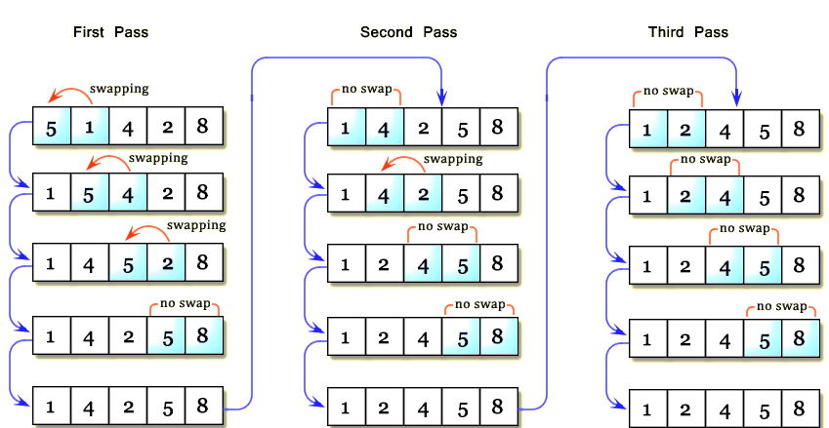
Bubble Sort

Slide 56
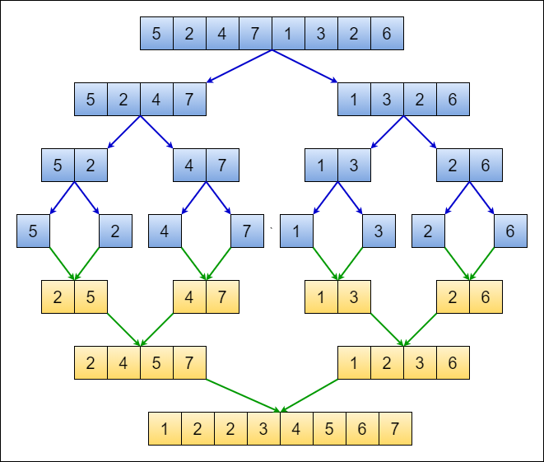
Merge Sort

Slide 57
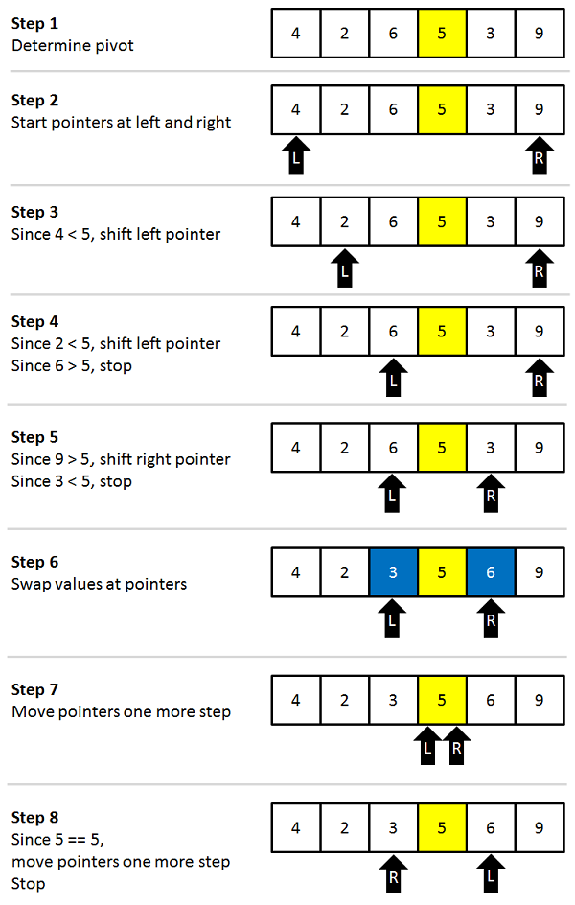
Quick Sort

Slide 58
Types of analysis
Types of analysis:
Best case Time complexity
Worst case Time complexity
Average case Time complexity
Best case Time complexity:
If an algorithm takes minimum amount of time to run to completion for a specific set of input is called best case time complexity.
Provides a lower bound on running time.

Slide 59
Types of analysis
Worst case Time complexity:
If an algorithm takes maximum amount of time to run to completion for a specific set of input is called worst case time complexity.
Provides an upper bound on running time.
Average case Time complexity:
If an algorithm takes average amount of time to run to completion for a specific set of input is called average case time complexity.
Provides a prediction about the running time.

Slide 60
Asymptotic Notations
The theoretical (priori) approach of analyzing an algorithm to measure the efficiency does not depend on the implementation of the algorithm.
In this approach, the running time of an algorithm describes as Asymptotic Notations.
Computing the running time of algorithm’s operations in mathematical units of computation and defining the mathematical formula of its run-time performance is referred to as Asymptotic Analysis.

Slide 61
Asymptotic Notations
An algorithm may not have the same performance for different types of inputs. With the increase in the input size, the performance will change.
Asymptotic analysis accomplishes the study of change in performance of the algorithm with the change in the order of the input size.
Using Asymptotic analysis, we can very well define the best case, average case, and worst case scenario of an algorithm.

Slide 62

Asymptotic Notations
Asymptotic notations are mathematical notations used to represent the time complexity of algorithms for Asymptotic analysis.
Following are the commonly used asymptotic notations to calculate the running time complexity of an algorithm.
$Ο$ Notation (Big 𝐎 notation)
$Ω$ Notation (Omega notation)
$θ$ Notation (Theta notation)

Slide 63
Asymptotic Notations
Asymptotic Notations are used,
To characterize the complexity of an algorithm.
To compare the performance of two or more algorithms solving the same problem.

Slide 64
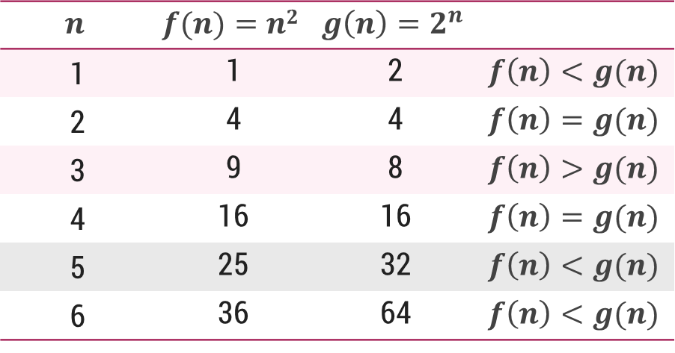

𝐎-Notation (Big 𝐎 notation)
The notation $Ο(n)$ is the formal way to express the upper bound of an algorithm's running time.
It measures the worst case time complexity or the longest amount of time an algorithm can possibly take to complete.
For a given function $g(n)$, we denote by $Ο(g(n))$the set of functions,
$Ο(g(n))$= {$f(n)$ : there exist positive constants $c$ and $n0$ such that $0≤f(n)≤cg(n)$for all $n0≤n$}

Slide 65
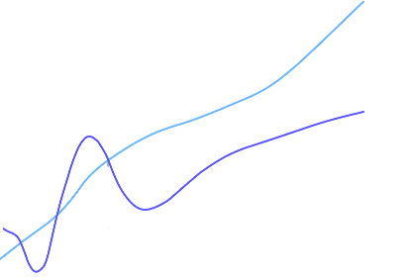

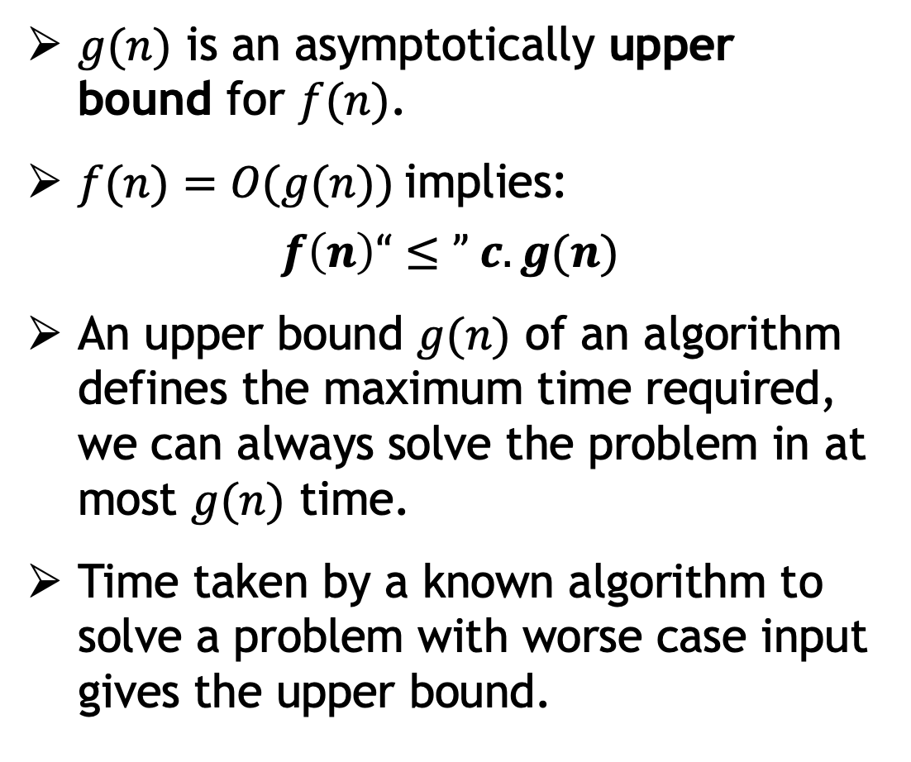


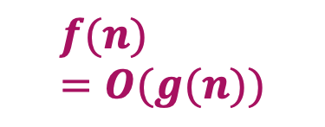

𝐎-Notation (Big 𝐎 notation)
$g(n)$ is an asymptotically upper bound for $f(n)$.
$f(n)=O(g(n))$implies:
$$f\left(n\right)“≤” c.g(n)$$
An upper bound $g(n)$ of an algorithm defines the maximum time required, we can always solve the problem in at most $g(n)$ time.
Time taken by a known algorithm to solve a problem with worse case input gives the upper bound.
$$c.g(n)$$
$$f(n)$$
$$n$$
$$n_{0}$$
$$f(n)=O(g(n))$$

Slide 66

𝛀-Notation (Omega notation)
Big Omega notation ($Ω$) is used to define the lower bound of any algorithm or we can say the best case of any algorithm.
This always indicates the minimum time required for any algorithm for all input values, therefore the best case of any algorithm.
When a time complexity for any algorithm is represented in the form of big-Ω, it means that the algorithm will take at least this much time to complete it's execution. It can definitely take more time than this too.
For a given function 𝑔(𝑛), we denote by $Ω($𝑔(𝑛)) the set of functions,
$Ω(g(n))=\{f(n):$there exist positive constants $c$ and $n_{0}$ such that $0≤cg\left(n\right)≤f\left(n\right)$for all $n_{0}≤n\}$

Slide 67
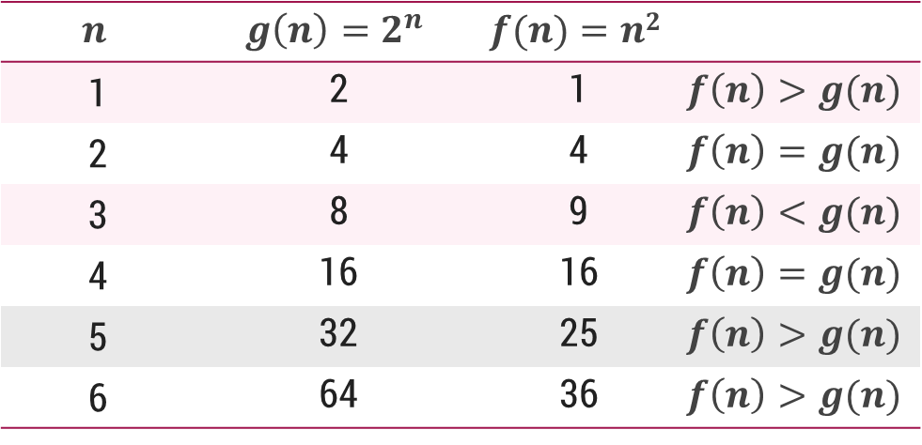

𝛀-Notation (Omega notation)
For a given function 𝑔(𝑛), we denote by $Ω($𝑔(𝑛)) the set of functions,
$Ω(g(n))=\{f(n):$there exist positive constants $c$ and $n_{0}$ such that $0≤cg\left(n\right)≤f\left(n\right)$for all $n_{0}≤n\}$

Slide 68
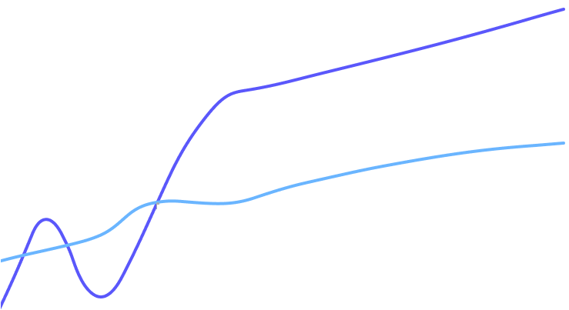






𝛀-Notation (Omega notation)
$g(n)$is an asymptotically lower bound for $f(n).$
$f(n)= Ω(g(n))$implies:
$$f(n)“≥” c.g(n)$$
A lower bound $g(n)$of an algorithm defines the minimum time required, it is not possible to have any other algorithm (for the same problem) whose time complexity is less than $g(n)$ for random input.
$$f(n)$$
$$c.g(n)$$
$$n$$
$$n_{0}$$
$$f(n)=Ω(g(n))$$

Slide 69

𝛉-Notation (Theta notation)
The notation $θ(n)$is the formal way to enclose both the lower bound and the upper bound of an algorithm's running time.
Since it represents the upper and the lower bound of the running time of an algorithm, it is used for analyzing the average case complexity of an algorithm.
The time complexity represented by the Big-$θ$ notation is the range within which the actual running time of the algorithm will be.
So, it defines the exact Asymptotic behavior of an algorithm.
For a given function 𝑔(𝑛), we denote by θ(𝑔(𝑛)) the set of functions,
$θ(g(n)) = \{f(n) :$there exist positive constants $c_{1}, c_{2} and n0 such that 0≤c_{1}g\left(n\right)≤f\left(n\right)≤c_{2}g\left(n\right) for all n0≤n\}$

Slide 70
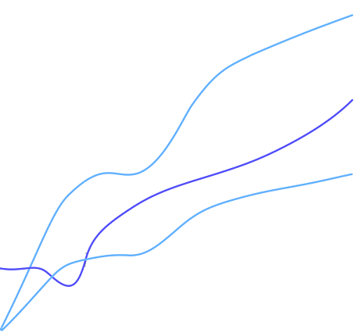



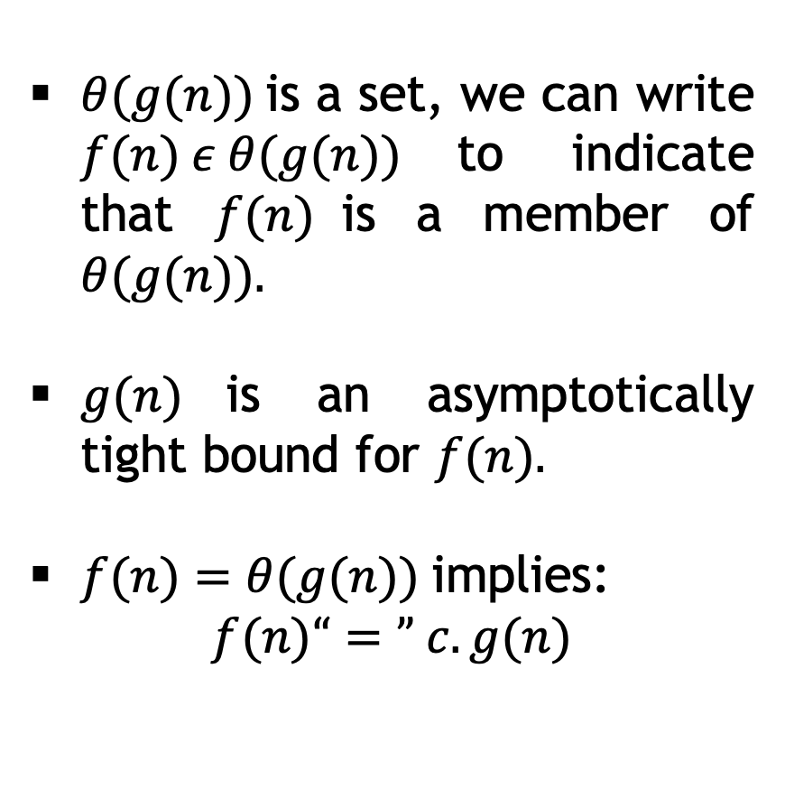


𝛉-Notation (Theta notation)
$$c_{2}.g(n)$$
$θ(g(n))$is a set, we can write $f(n) ε θ(g(n))$to indicate that $f(n)$is a member of $θ(g(n)).$
$g(n)$is an asymptotically tight bound for $f(n).$
$f(n)=θ(g(n))$implies:
$$f(n)“=” c.g(n)$$
$$f(n)$$
$$c_{1}.g(n)$$
$$n$$
$$n_{0}$$
$$f(n)=θ(g(n))$$

Slide 71
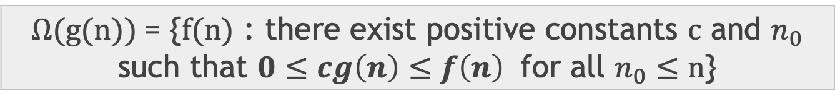

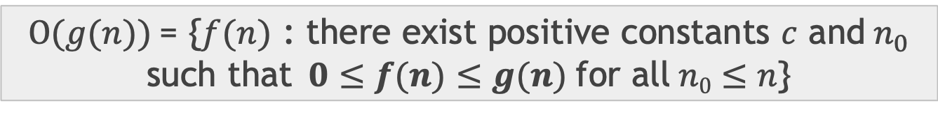


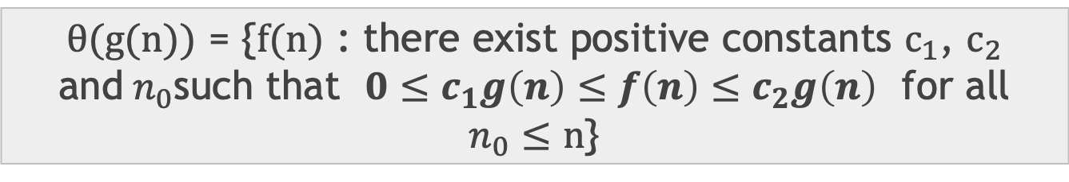
Asymptotic notations – Cases
O-Notation (Big O notation) (Upper Bound)
Ω-Notation (Omega notation) (Lower Bound)
θ-Notation (Theta notation) (Same order)
$Ο(g(n))$= {$f(n)$ : there exist positive constants $c$ and${ n}_{0}$ such that$0≤f(n)≤g(n)$for all$n0≤n$}
$$f(n)=O(g(n))$$
$Ω(g(n))$= {$f(n)$ : there exist positive constants $c$ and $n_{0}$ such that $0≤cg\left(n\right)≤f\left(n\right)$ for all $n_{0}≤n$}
$$f\left(n\right)=Ω(g(n))$$
$θ(g(n))$ = {$f(n)$ : there exist positive constants $c_{1}$, $c_{2}$ and${ n}_{0}$such that $0≤c_{1}g\left(n\right)≤f\left(n\right)≤c_{2}g\left(n\right)$ for all $n_{0}≤n$}
$$f(n)=θ(g(n))$$

Slide 72
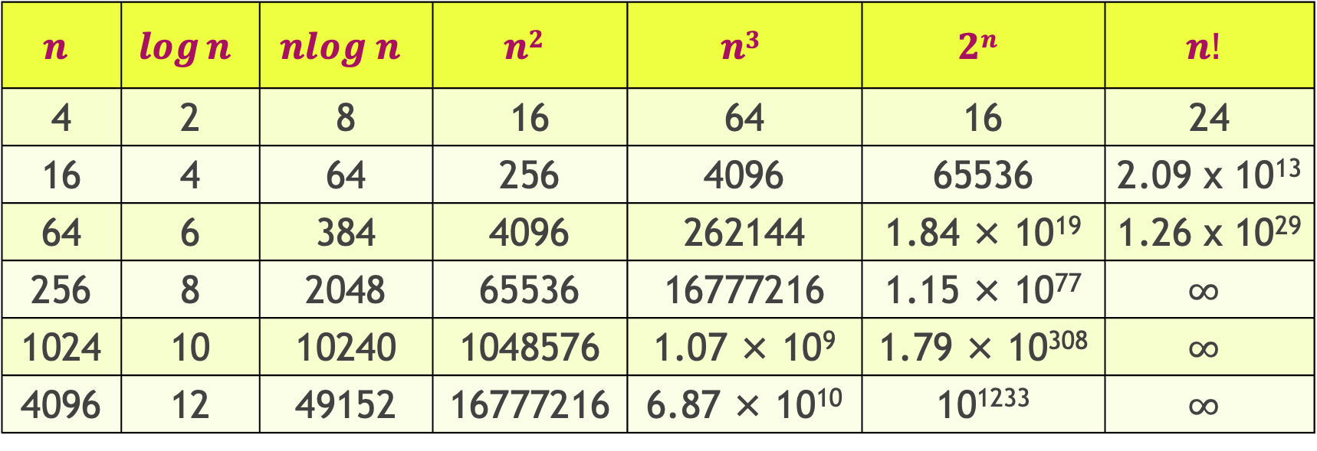
Common orders of magnitude
$$n$$ | $$\log{n}$$ | $$nlog n$$ | $$n2$$ | $$n3$$ | $$2n$$ | $$n!$$
4 | 2 | 8 | 16 | 64 | 16 | 24
16 | 4 | 64 | 256 | 4096 | 65536 | 2.09 x 10¹³
64 | 6 | 384 | 4096 | 262144 | 1.84 × 10¹⁹ | 1.26 x 10²⁹
256 | 8 | 2048 | 65536 | 16777216 | 1.15 × 10⁷⁷ | $$∞$$
1024 | 10 | 10240 | 1048576 | 1.07 × 10⁹ | 1.79 × 10³⁰⁸ | $$∞$$
4096 | 12 | 49152 | 16777216 | 6.87 × 10¹⁰ | 10¹²³³ | $$∞$$
Growth of function
$$n!$$ | $$en$$ | $$2n$$ | $$n3$$ | $$n2$$ | $$nlogn$$ | $$n$$ | $$\sqrt{n}$$ | $$logn$$ | $$1$$

Slide 73
Examples
main()
{
x = y + z;
}
This statement is executed once.
O(1)
Order of magnitude is one.

Slide 74
Examples
main()
{
For (i = 1 to n)
x = y + z;
}
O(n)
main()
{
For (i = 1 to n)
For (j = 1 to n)
x = y + z;
}
O(n²)

Slide 75
Examples
main()
{ x = y + z;
For (i = 1 to n)
x = y + z;
For (i = 1 to n)
For (j = 1 to n)
x = y + z;
}
O(n² + n + 1) → O(n²)
main()
{
while (n>1) {
n = n/2;
}
}
O(log₂n)

Slide 76
Examples
main()
{
while (n < 1) {
n = n/2;
}
}
*n is +ve integer
O(1)
main()
{
while (n<=1) {
n = n/2;
}
}
Infinite

Slide 77
Examples
main()
{
For (i = 1 to n)
For (j = 1 to n/2)
x = y + z;
}
O(n²)

